Slide 1







Slide 2
Agile Methodology

Slide 3
What is Agile?
Agile is a project management methodology that breaks down larger projects into smaller, manageable chunks known as iterations
At the end of every iteration (which typically takes places over a consistent time interval), something of value is produced.
The product that’s produced during every iteration should be able to be placed into the world to receive feedback from stakeholders or users.
Contrary to Waterfall project management, agile is strictly sequenced: you do not commence design until research is complete and development doesn’t commence until all designs are signed off.
With agile, developers, designers, and business people are simultaneously working together.

Slide 4
The Agile Life Cycle
The objective of agile is to produce shorter product development cycles and deliver more frequent releases than the traditional waterfall management methodology.
The shorter time frame lets project teams react to changes in a client’s needs more effectively.
You could use different agile management frameworks, with Kanban and Scrum being the most common ones. Whichever framework you choose, the entire agile methodology follows the same process, which entails:
1. Project Planning
2. Product Roadmap Creation
3. Release Planning
4. Sprint Planning
5. Daily Meetings
6. Sprint Review

Slide 5
The Benefits of Agile
Digital - Many companies are moving to the digital workplace, agile is an excellent fit for the organizations looking to transform the way they manage projects and operate in general.
Speed to Market - To improve and streamline the development process in a bid to quickly identify and adjust for defects and issues.
Flexibility - Offers a way for teams and developers to deliver a better project, faster, through short, iterative sprints/sessions.
Risk Management
Cost Control
Quality

Slide 6
Diff between Agile and Waterfall
 | Agile | Waterfall
Project Scope | works perfectly, even when the scope isn’t defined in advance | works correctly when the scope is well-defined in advance
Project Team | small or mid-sized dedicated teams working in high coordination | large teams which decrease the coordination among members
Customers | customers to be available through the entire project | customers are only needed at milestones
Feature Prioritization | features are usually prioritized and issues dealt with according to their priorities | Features are never prioritized
Funding | works well by increasing the funding efficiency | works perfectly by minimizing fixed funding through the up-front contracts.
Project Changes | allows for intermittent changes during an ongoing process | doesn’t allow changes in between the project process, and in case a mistake occurs, the project must begin from scratch

Slide 7
Scrum Framework

Slide 8
About Scrum
Scrum is a management framework for incremental product development using one or more cross-functional, self-organizing teams of about seven people each.
It provides a structure of roles, meetings, rules, and artifacts. Teams are responsible for creating and adapting their processes within this framework.
Scrum uses fixed-length iterations, called Sprints. Sprints are no more than 30 days long, preferably shorter. Scrum teams try to build a potentially releasable (properly tested) product increment every Sprint

Slide 9
Scrum Roles
Scrum Development Team
Product Owner
Scrum Master

Slide 10
Scrum Development Team
Cross-functional (e.g., includes members with testing skills, and others not traditionally called developers: business analysts, designers, domain experts, etc.)
Self-organizing / self-managing, without externally assigned roles
Plans one Sprint at a time with the Product Owner
Has autonomy regarding how to develop the increment
Intensely collaborative
Most successful when located in one team room, particularly for the first few Sprints
Most successful with long-term, full-time membership. Scrum moves work to a flexible learning team and avoids moving people or splitting them between teams.
6 ± 3 members

Slide 11
Product Owner
Single person responsible for maximizing the return on investment (ROI) of the development effort
Responsible for product vision
Constantly re-prioritizes the Product Backlog, adjusting any longterm expectations such as release plans
Final arbiter of requirements questions
Decides whether to release
Decides whether to continue development
Considers stakeholder interests
May contribute as a team member

Slide 12
Scrum Master
Works with the organization to make Scrum possible
Ensures Scrum is understood and enacted
Creates an environment conducive to team self-organization
Shields the team from external interference and distractions to keep it in group flow (a.k.a. the zone)
Promotes improved engineering practices
Has no management authority over the team
Helps resolve impediments

Slide 13
Scrum Artifacts

Slide 14
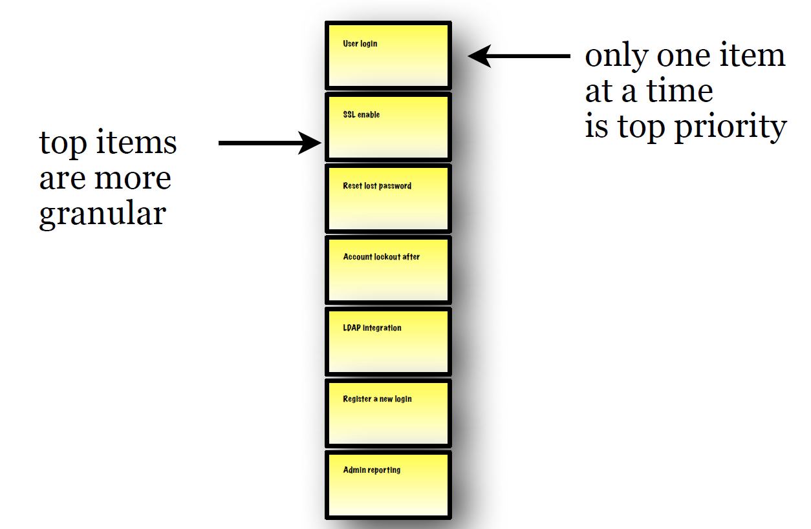
Product Backlog
Force-ranked (prioritized) list of desired functionality
Visible to all stakeholders
Any stakeholder (including the Team) can add items
Constantly re-prioritized by the Product Owner
Constantly refined by the Scrum Team
Items at top should be smaller (e.g. smaller than 1/4 of a Sprint) than items at bottom

Slide 15
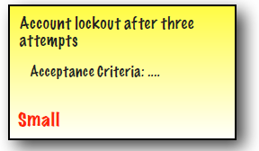
Product Backlog Item (PBI)
• Describes the what more than the how of a customer-centric feature
• Often written in User Story form
• Has a product-wide definition of done to prevent technical debt
• May have item-specific acceptance criteria
• Effort is estimated by the Development Team, ideally in relative units
(e.g., story points)

Slide 16
Sprint Backlog
A Sprint in Scrum is a short period of time wherein a development team works to complete specific tasks, milestones, or deliverables.
Sprints, also referred to as “iterations,” essentially break the project schedule into digestible blocks of time in which smaller goals can be accomplished.
Consists of selected PBIs negotiated between the team and the Product Owner during the Sprint Planning Meeting
No changes are made during the Sprint that would endanger the Sprint Goal
Initial tasks are identified by the team during Sprint Planning Meeting
Team will discover additional tasks needed to meet the Sprint Goal during Sprint execution
Visible to the team
Referenced during the Daily Scrum Meeting

Slide 17
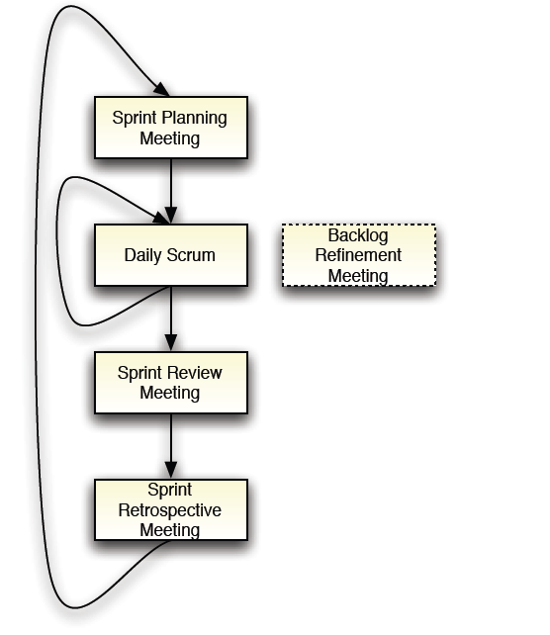
Scrum Meetings

Slide 18
Sprint Planning Meeting
The Product Owner, ScrumMaster, and Dev Team plan each Sprint at the very start of the Sprint
The meeting is timeboxed to 2 hours x the weeks in the Sprint (=4 hour timebox for 2-week Sprints)
The plan they create is known as the Sprint Backlog
Scrum doesn’t specify how to plan a Sprint — it’s up to the ScrumMaster, Dev Team, and Product Owner to find the most effective way to do it
By experimenting from Sprint to Sprint, we discover…
How detailed and firm the requirements need to be to get started
What unit to use in estimating, how fine-grained the estimates need to be, and how much buffer we need to put in
How detailed a task breakdown our Dev Team needs, in order to work effectively during a Sprint

Slide 19
Daily Scrum Meeting
Purpose
Enable the Dev Team to give each other a brief daily update
Enable the Dev Team to make any blocks visible to everyone
Daily, the Dev Team stands in a circle and reports:
“Since yesterday I did…”
“By tomorrow I will try to do…”
“My blocks are…” (or “I have no blocks”)
15-minute timebox
During meeting: everyone listens, no discussion
After meeting is done: further discussion as needed
Product Owner can attend, but must not interfere
ScrumMaster makes note of the blocks
After Daily Scrum, ScrumMaster helps remove blocks, and people can meet in smaller groups to discuss issues

Slide 20
Product Backlog Refinement
Product Owner, Dev Team, and ScrumMaster take time in each Sprint to look at the upcoming Product Backlog Items (User Stories) which will be worked on in next 2-3 Sprints
Take large upcoming Product and split them into smaller slices; ideally, small enough that 1-2 people could completely finish them in 3-4 days (“1-2-3-4”)
Get a more detailed shared understanding of the requirements for the upcoming Product Backlog Items (User Stories)
No fixed format, timing, or timebox
Try starting with a 2-hour session for Product Owner, Dev Team, and ScrumMaster halfway through the Sprint

Slide 21
Sprint Review
Purpose: Inspect and Adapt the Product
Meeting at the end of the Sprint (timeboxed to 1 hour x the number of weeks in the Sprint)
The PO, SM, Dev Team, and stakeholders get “hands on” with what the Dev Team has produced in the Sprint
We inspect the quality, and whether it is “done”
We inspect whether it truly serves customer needs
We try to find improvements to make in the future (Product Owner adds these on the Product Backlog)
Get real-world customers or end-users to attend and give hands-on feedback

Slide 22
Sprint Retrospective
Purpose: Inspect and Adapt Our Practices
Last activity in each Sprint (timeboxed to 1 hour x the number of weeks in the Sprint)
The PO, SM, and Dev Team talk about what they experienced and observed during the Sprint, both positive and negative
They create a specific plan of action for improving their practices in the next Sprint
Probably the single most important practice in Scrum. The Scrum Team does this every Sprint!

Slide 23
What is AgileTesting
Agile Testing is a practice that a QA follows in a dynamic environment where testing requirements keep changing according to customer needs. It is done parallel to the development activity where the testing team receives frequent small codes from the development team for testing.

Slide 24
What qualities should a good Agile tester have
He should be able to understand the requirements quickly.
• He should know Agile concepts and principals
• As requirements keep changing, he should understand the risk involved in it.
• The agile tester should be able to prioritize the work based on the requirements. •
Communication is a must for an Agile tester as it requires a lot of communication with developers and business associates.

Slide 25
What is zero sprint in agile

Slide 26


